Slide 1



Java EE - Introduction
What is Java EE ?
www.supinfo.com
Copyright © SUPINFO. All rights reserved
Notes:
© SUPINFO International University - http://www.supinfo.com
SUPINFO vous permet de partager ce document
Vous êtes libre de :
Partager — reproduire, distribuer et communiquer ce document Remixer — modifier ce document
A condition de respecter les règles suivantes :
Indication obligatoire de la paternité — Vous devez obligatoirement préciser l’origine « SUPINFO » du document au début de celui-ci de la même manière qu’indiqué par SUPINFO International University – Notamment en laissant obligatoirement la première et la dernière page du document, mais pas d'une manière qui suggérerait que SUPINFO International University vous soutiennent ou approuvent votre utilisation du document, surtout si vous le modifiez. Dans ce dernier cas, il vous faudra obligatoirement supprimer le texte « SUPINFO Official Document » en tête de page et préciser notamment la page indiquant votre identité et les modifications principales apportées.
En dehors de ces dispositions, aucune autre modification de la première et de la dernière page du document n’est autorisée.
NOTE IMPORTANTE : Ce document est mis à disposition selon le contrat CC-BY-NC-SA Creative Commons disponible en ligne http://creativecommons.org/licenses ou par courrier postal à Creative Commons, 171 Second Street, Suite 300, San Francisco, California 94105, USA modifié en ce sens que la première et la dernière page du document ne peuvent être supprimées en cas de reproduction, distribution, communication ou modification. Vous pouvez donc reproduire, remixer, arranger et adapter ce document à des fins non commerciales tant que vous respectez les règles de paternité et que les nouveaux documents sont protégés selon des termes identiques. Les autorisations au-delà du champ de cette licence peuvent être obtenues à support@supinfo.com.
© SUPINFO International University – EDUCINVEST - Rue Ducale, 29 - 1000 Brussels Belgium . www.supinfo.com

Slide 2


Course objectives
Java EE - Introduction
By completing this course, you will be able to:
Explain what the JCP is
Explain the Java EE Application Model
Explain what are the different Java EE containers
Describe some of Java EE 6 APIs

Slide 3

Course topics
Java EE - Introduction
Course’s plan
Overview
Java EE Application Model
Java EE Containers
Java EE 6 APIs

Slide 4
Overview
Java EE - Introduction

Slide 5

Presentation
Overview
Platform designed for Enterprise Application development
Enterprise Applications provide the business logic for an enterprise
The aim of Java EE Platform is to provide developers with a set of powerful APIs to :
Shortening development time
Reducing application complexity
Improving application performance

Slide 6
Java Community Process
Overview
Java EE Platform is developed through the Java Community Process (JCP)
Create Java Specification Request (JSR)
Ensure Java technology’s standard of stability and cross-platform compatibility
JSRs are the actual descriptions of proposed and final specifications for the Java platform
Example :
JSR 315 is Servlet 3.0
JSR 317 is Java Persistence API 2.0

Slide 7







Java Community Process
Overview
JCP Executive Committee is the group of members guiding the JCP
Composed of :
And others…
Notes:
http://www.jcp.org/en/participation/committee

Slide 8
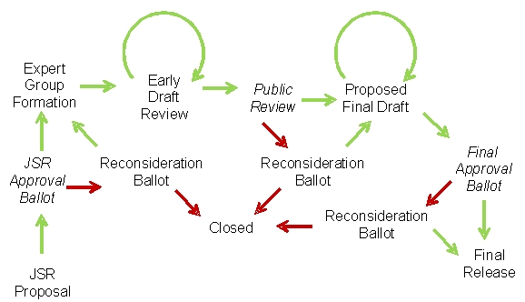
JSR Lifecycle
Overview
Source: http://blogs.oracle.com/darcy/entry/pictorial_jcp

Slide 9


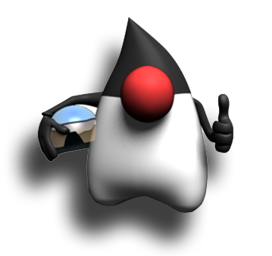
Stop-and-think
Overview
Do you have any questions ?
???

Slide 10
Java EE Application Model
Java EE - Introduction

Slide 11
Advantages
Java EE Application Model
The basis of Java EE application model is the Java programming language and the JVM
Portability
Security
Developer productivity
The Java EE application model defines an architecture for implementing multitier applications
Scalability
Accessibility
Manageability

Slide 12
Multitiered Applications
Java EE Application Model
Application logic is divided into components according to function
Each application components can be installed on various machines depending on the tier to which the component belongs
A Java EE multitiered application is generally composed of :
Client-tier components : run on the client machine
Web-tier components : run on the Java EE server
Business-tier components : run on the Java EE server
Enterprise Information System : run on the EIS server

Slide 13
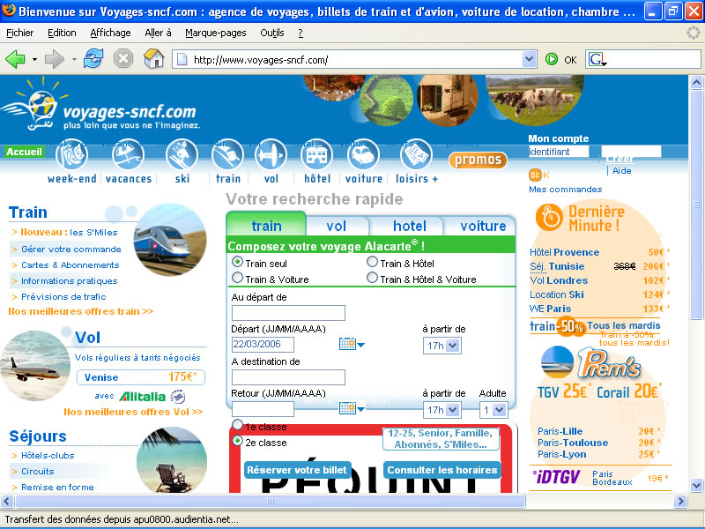
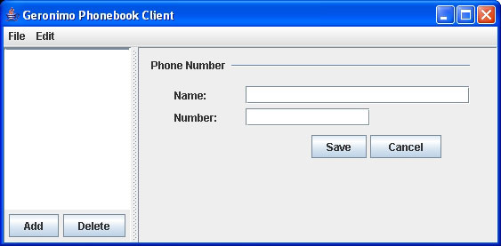



Multitiered Applications
Java EE Application Model
Application Client
Web
Pages
Client
Tier
Client
Machine
JavaServer
Faces
Pages
Web
Tier
Java EE
Server
Enterprise
Beans
Enterprise
Beans
Business
Tier
EIS
Tier
Database
Server
Database
Database

Slide 14
Multitiered Applications
Java EE Application Model
Application Client
Web
Pages
Client
Tier
Client
Machine
JavaServer
Faces
Pages
Web
Tier
Java
Server
Enterprise
Beans
Enterprise
Beans
Business
Tier
Java EE
Server
EIS
Tier
Database
Server
Database
Database

Slide 15
Java EE Components
Java EE Application Model
The Java EE specification defines the following Java EE components :
Application clients and applets
→ Run on the client
Servlet, JSF and JSP technology components
→ Web components, run on the server
Enterprise JavaBeans components
→ Business components, run on the server

Slide 16
Stop-and-think
Java EE Application Model
Do you have any questions ?
???

Slide 17
Java EE Containers
Java EE - Introduction

Slide 18
Presentation
Java EE Containers
Containers are the interface between a component and the low-level platform specific functionality that supports it
Java EE module (Servlets, EJB, ...) must be deployed in its container to be able to be executed
Containers provide some services as :
Security
Transaction management
Remote connectivity

Slide 19
Container Types
Java EE Containers
Application Client
Web
Pages
JavaServer
Faces
Pages
Web
Container
Enterprise
Beans
Enterprise
Beans
EJB
Container

Slide 20
Container Types
Java EE Containers
Java EE Server :
The runtime portion of a Java EE product
Provides EJB and Web containers
Enterprise JavaBeans container :
Manages the execution of EJBs
Web container :
Manages the execution of web pages and servlets

Slide 21




Java EE Server
Java EE Containers
Remember last year… We used Tomcat to execute our Servlet based application
Tomcat is just a Web container
We can’t use it to manage EJBs !
The best known application servers are :

Slide 22
Stop-and-think
Java EE Containers
Do you have any questions ?
???

Slide 23
Java EE 6 APIs
Java EE - Introduction

Slide 24
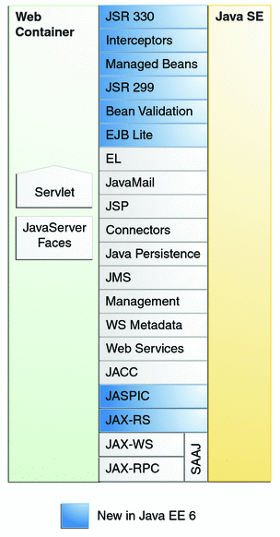
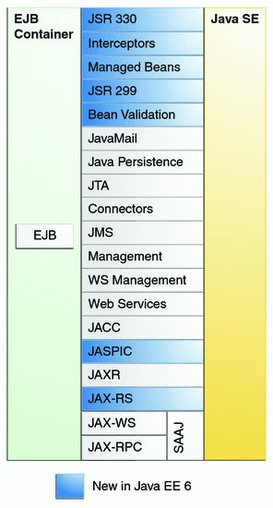
Overview
Java EE 6 APIs

Slide 25

Servlet 3.0
Java EE 6 APIs
Java Servlet 3.0 Technology (JSR 315) :
The new version of Java Servlet
Annotation support
No need to declare each Servlet inside deployment descriptor !
Asynchronous support
…
For more information, look at the new Servlet course available on http://courses.supinfo.com !

Slide 26

Java Persistence API
Java EE 6 APIs
Java Persistence 2.0 (JSR 317) :
Java standards-based solution for persistence
Use an object/relational mapping approach
We saw it last year, remember ?
We’ll use it again this year ! ☺

Slide 27

Enterprise JavaBeans
Java EE 6 APIs
Enterprise JavaBeans 3.1 (JSR 318) :
Component that encapsulates the business logic
Provide :
Transaction processing
Concurrency control
Remote procedure calls
Exposing business methods as Web Services
We’ll see it this year !

Slide 28

JavaServer Faces
Java EE 6 APIs
JavaServer Faces 2.0 (JSR 314) :
A Component Based Framework for Web
Support :
Input validation
Event handling
Data conversion
Page navigation configuration
…
We’ll see it this year !

Slide 29

Bean Validation
Java EE 6 APIs
Bean Validation (JSR 303) :
Define a meta-data model and API for JavaBean validation based on annotations
New in Java EE 6
We’ll see it this year !

Slide 30
Stop-and-think
Java EE 6 APIs
Do you have any questions ?
???

Slide 31

Course summary
Java EE - Introduction
JCP & JSR
Multitiered Application
Web Container
EJB Container

Slide 32


The end
Java EE - Introduction

